Slide 1

CS 449 Rec
Dynamic Memory Allocation – Part 1

Slide 2


Announcements
Malloc lab is out
Break it into small parts
There will be a practice exam before final

Slide 3

Schedule
Walkthrough
Concepts
Quizzes
Implementation
Next time: Implementation, Debugging, heap checker

Slide 4
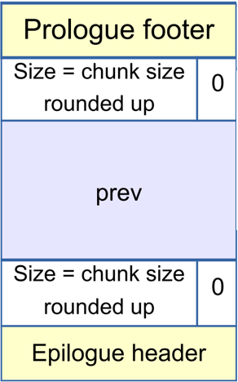
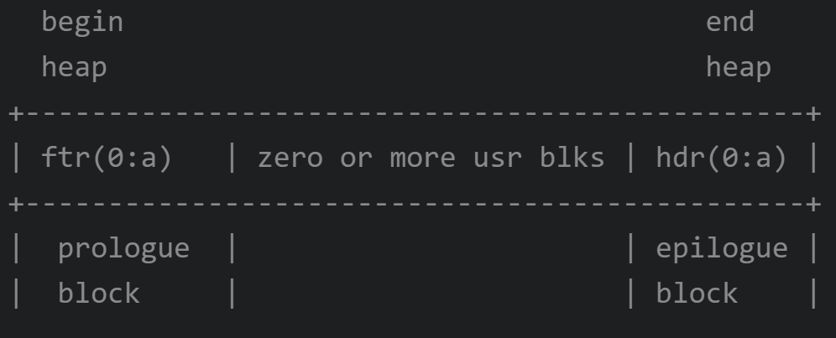
Malloc
Payload must be 16-byte aligned
Explicit memory allocation <-> automatic memory allocation
C/C++ <-> Java/Python…
Dynamic: Good for situations where the size of the allocations is unknown until runtime
Which part of memory does malloc manipulate?
Higher/lower address as it grows?
Initialization of your memory

Slide 5
Free
There’re many ways to track the free blocks, each with its own advantage
When size is/isn’t considered, if freed blocks should be merged, etc.
A (doubly) linked list of free blocks
Implicit free list (malloc-ref)
Have links to ALL blocks, going by length
Explicit free list (your program)
Have links to only free blocks; each node contains a pointer to the next free (could be anywhere: logical vs physical)
A doubly linked list starting with LIFO
Segregated free list
To further improve speed when size matters
“adding a level of abstraction”

Slide 6
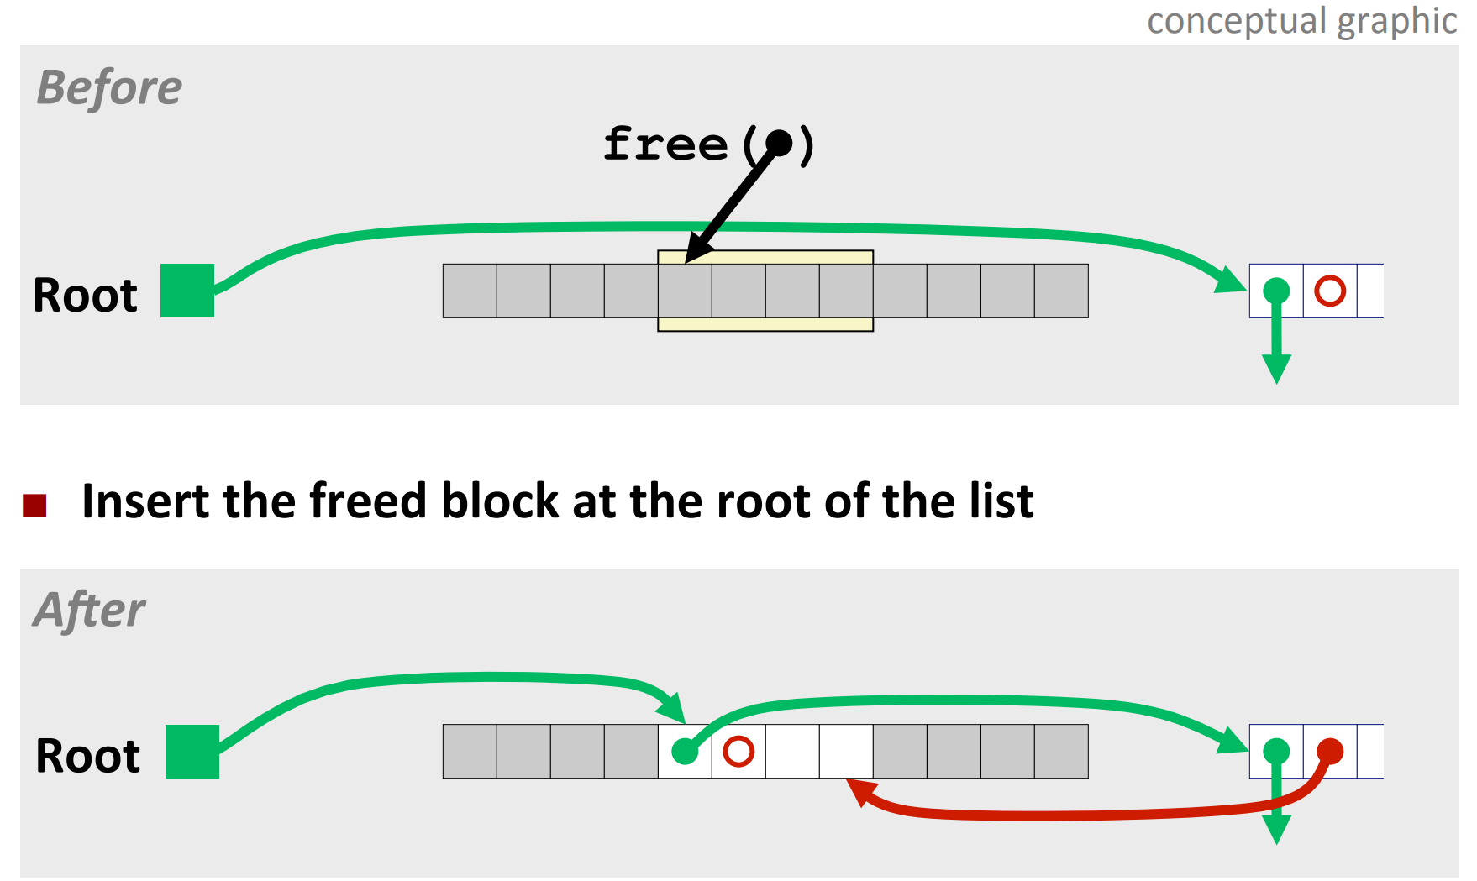
Freeing with LIFO (add to beginning) Case 1

Slide 7
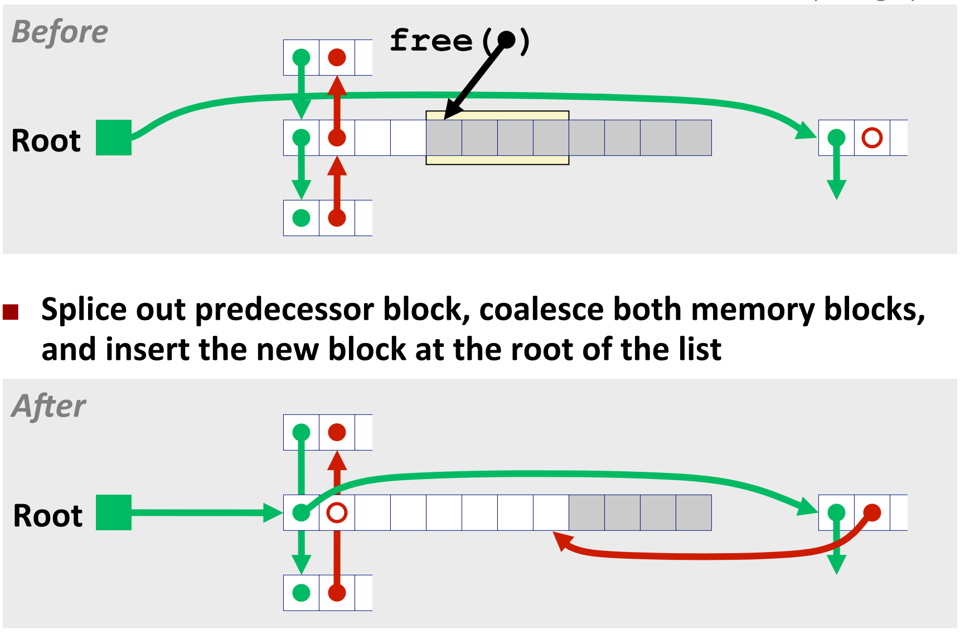
Freeing with LIFO Case 2

Slide 8
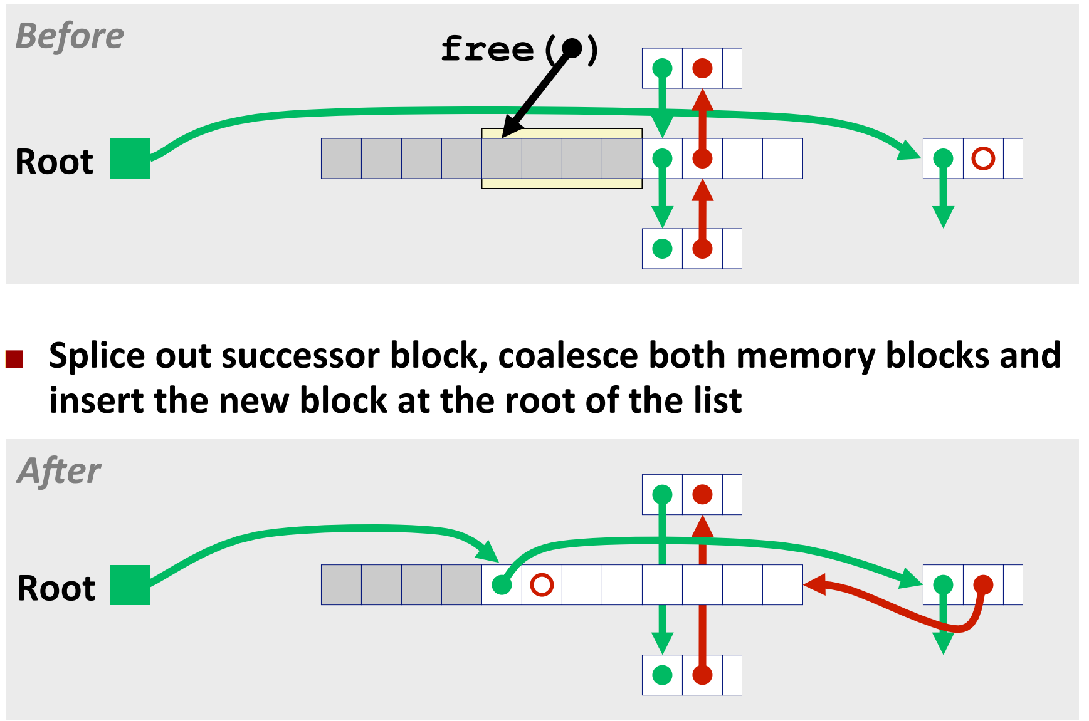
Freeing with LIFO Case 3

Slide 9
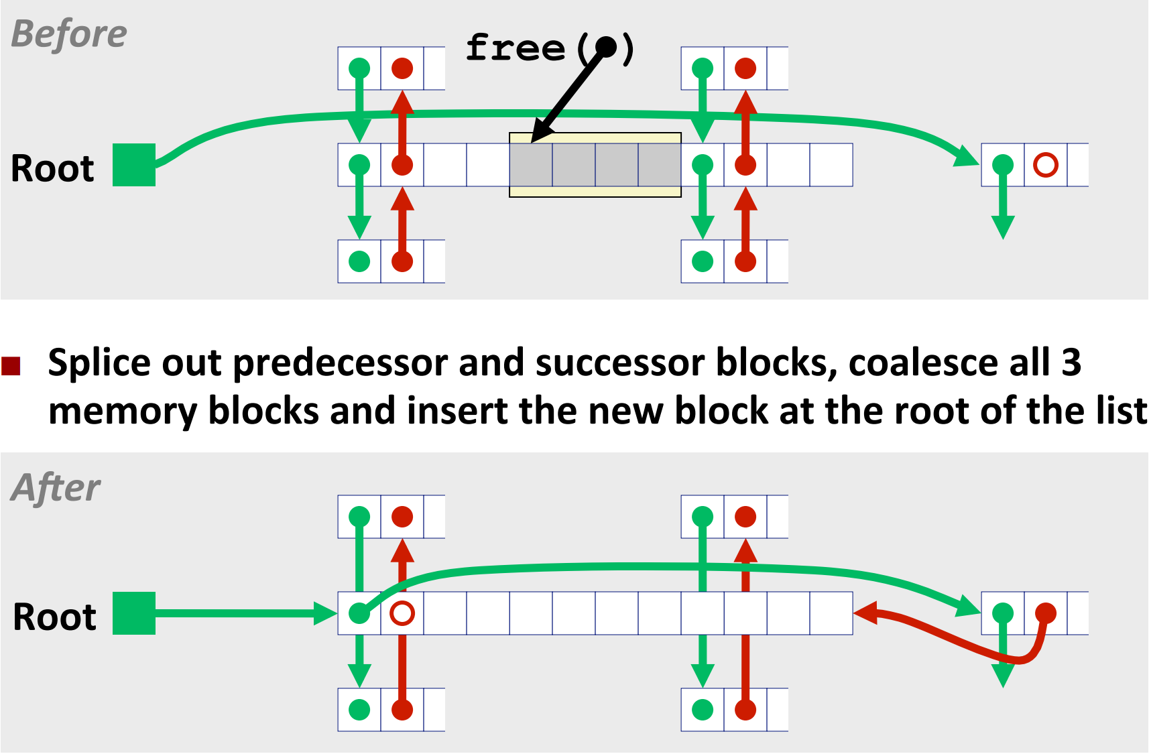
Freeing with LIFO Case 4

Slide 10
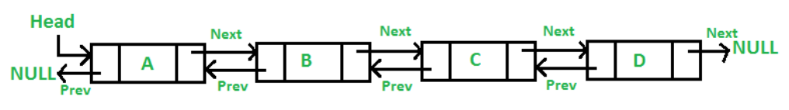
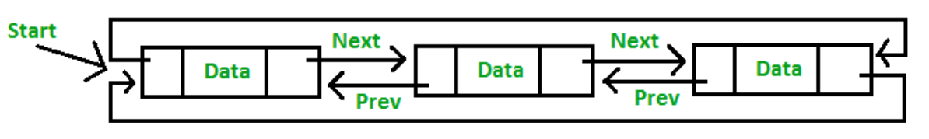
Linear vs Circular doubly linked list

Slide 11
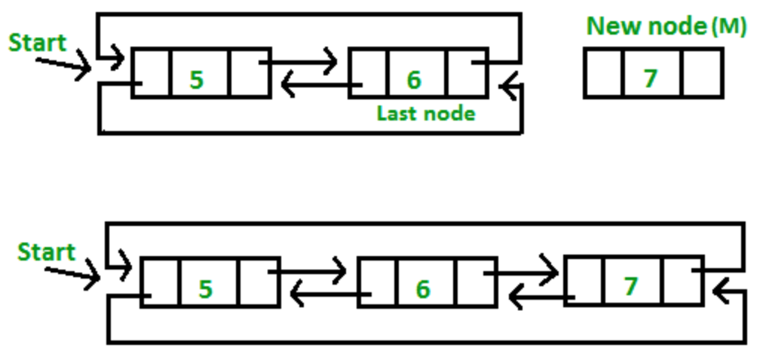


Example of operations: circular (linear is easier)
Adding new node at the “end”
Credits to geeksforgeeks.org

Slide 12
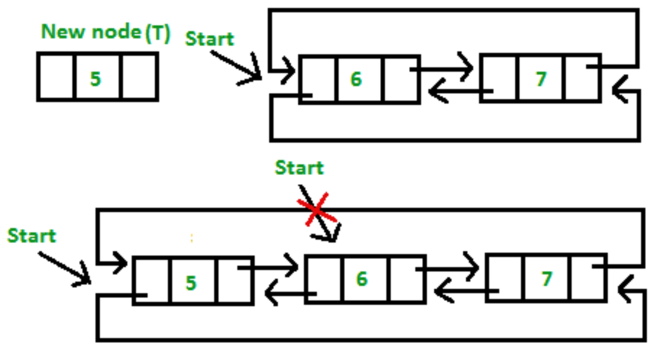

Insertion at the beginning

Slide 13
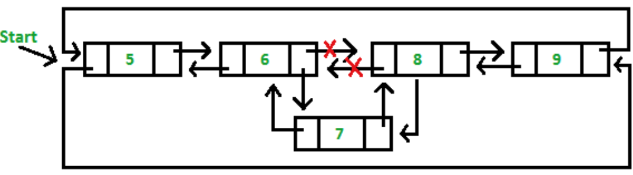
Insertion in between

Slide 14
And other cases
Consider cur == head cur == tail else head/tail cases
More to be discussed in heap checker next time

Slide 15
Issues (from lecture)
How do we know how much memory to free given just a pointer?
How do we keep track of the free blocks?
What do we do with the extra space when allocating a structure that is smaller than the free block it is placed in?
How do we pick a lock to use for allocation – many might fit?
How do we reuse a block that has been freed?
Choices, So pros & cons

Slide 16
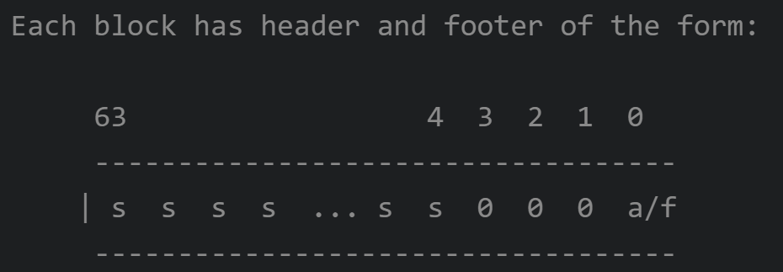
How much to free?
Header: the length of a block in the word preceding the block
So it requires an extra word for every allocated block
Note that free takes a pointer, not a size
Footer (optional, but recommended for this lab): the replication of the size info at a word following the allocatable block (it’s not in struct)

Slide 17
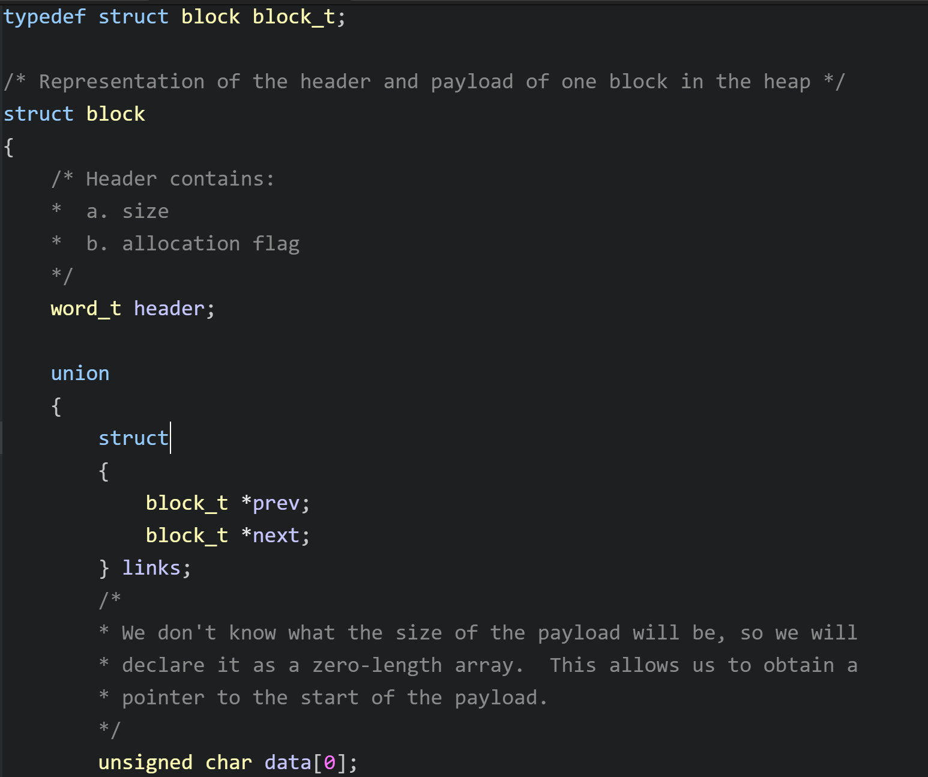
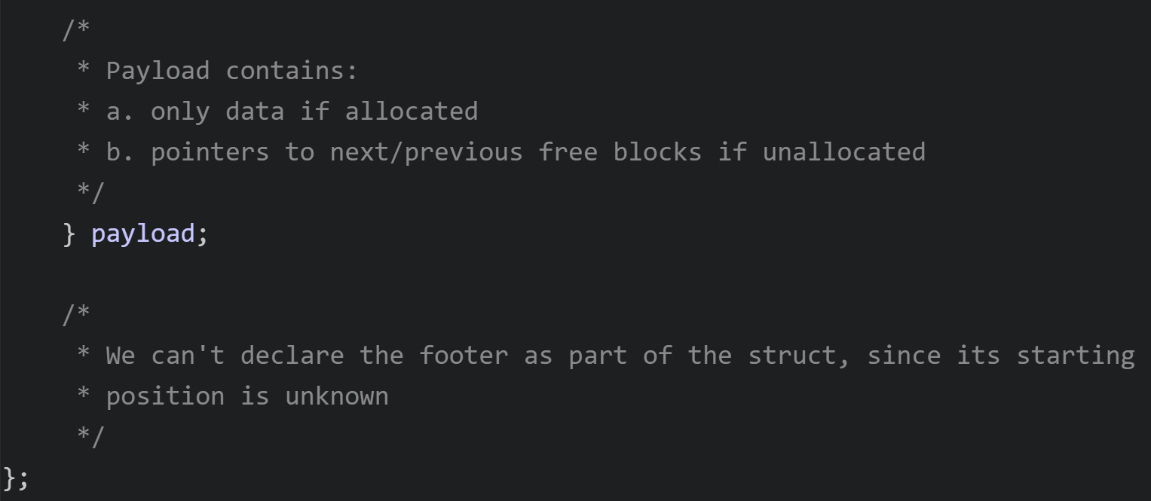
Block from mm.c
Notes:
Footer not defined

Slide 18
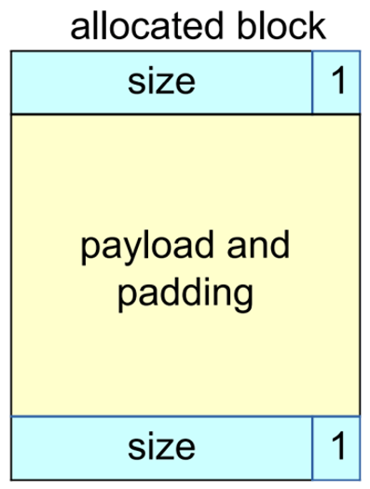
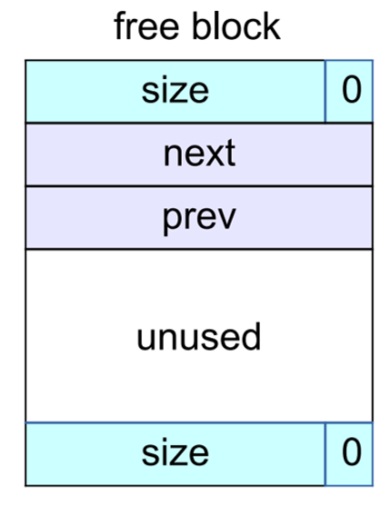
Implicit vs Explicit free list
Implicit: stores size
Explicit: prev, next, size

Slide 19
Splitting the block
Allocated < free
First fit: search linearly starting from some location and pick the first block that fits
Best fit: choose the smallest block that’s big enough to fit the requested allocation size
“Good fit”: a blend between the two
Don’t forget to change your prev and next

Slide 20
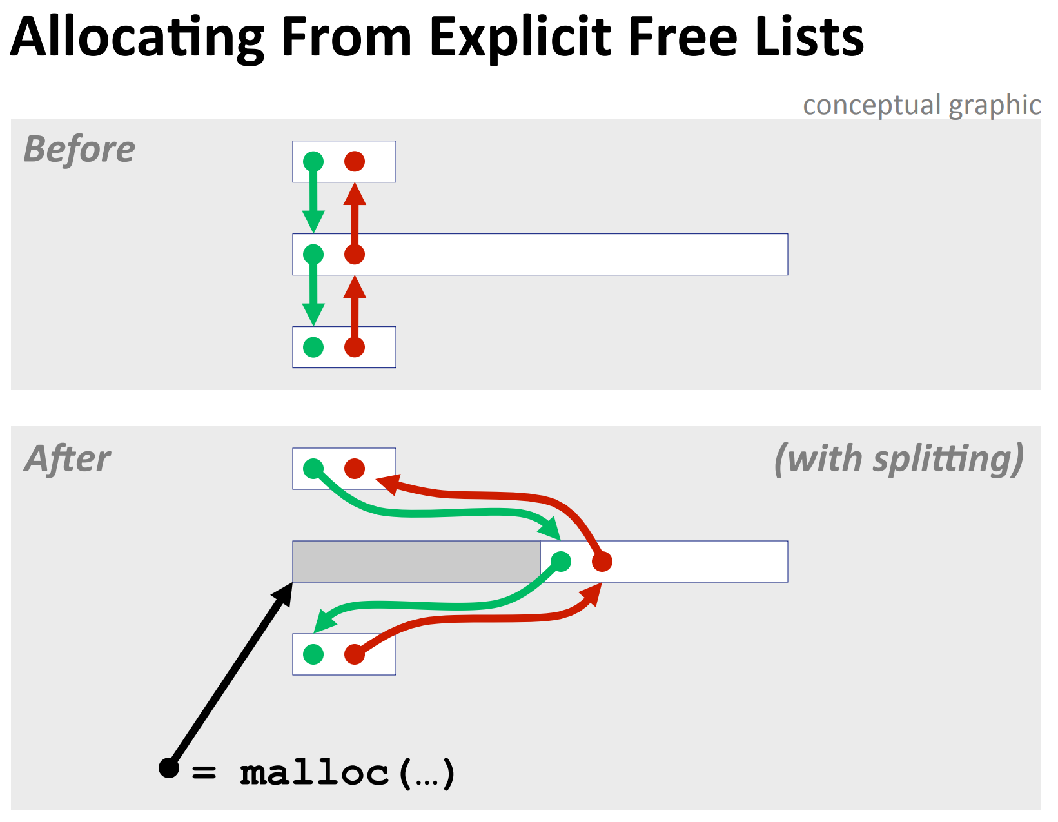

Slide 21
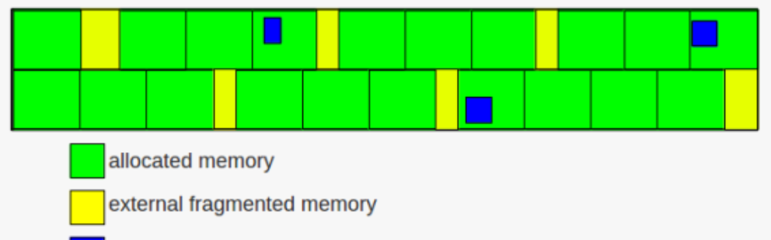
Fragmentation
External fragmentation caused by?
Internal fragmentation caused by?

Slide 22
Coalescing
Slides 56-60 from lecture
Pointer manipulation + size updates

Slide 23
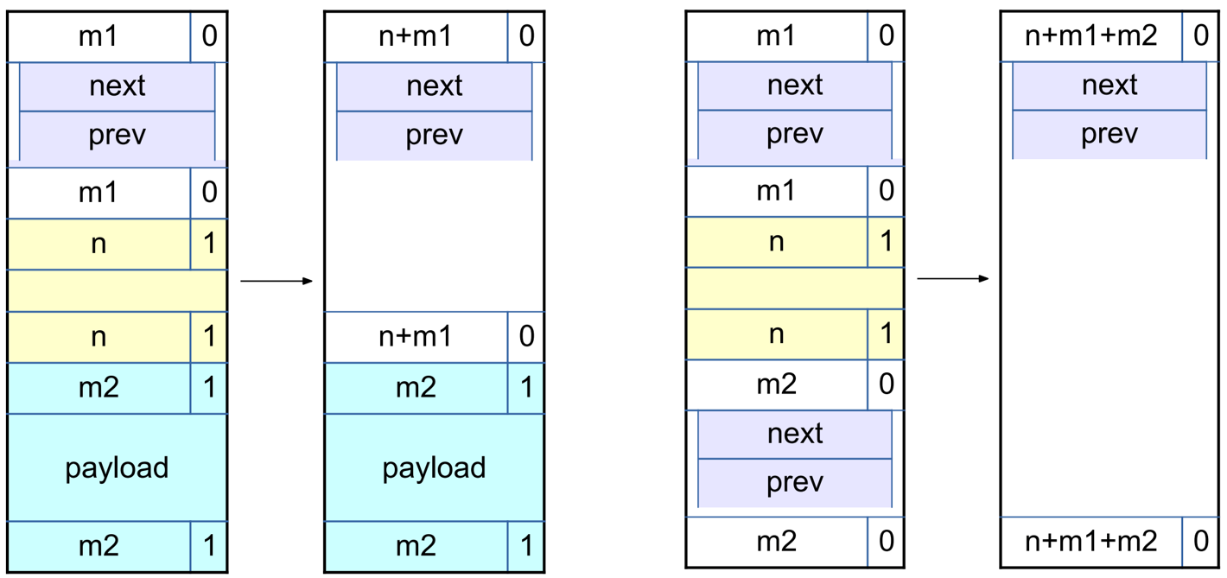
Examples

Slide 24
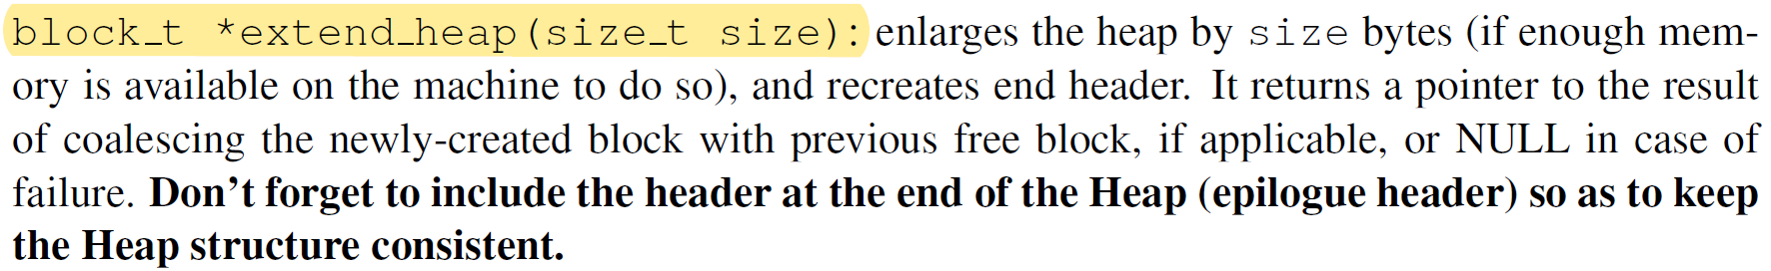
Extending the heap
If we can’t find a usable free block

Slide 25
Break value (mm_init)
Brk(void* addr): sets the end of the data segment to the value specified by addr (should return 0 on success)
sbrk(num_bytes): allocates space and returns pointer to start
sbrk(0) = the end of the heap
Mem_sbrk()
For speed, extend the heap by a little more than you need immediately
Use what you need out of the new space, add the rest as a free block

Slide 26
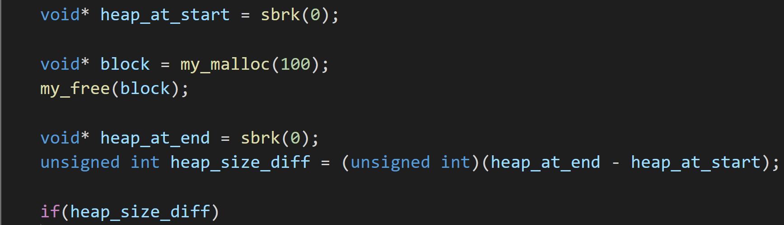

Slide 27
Edge cases

Slide 28
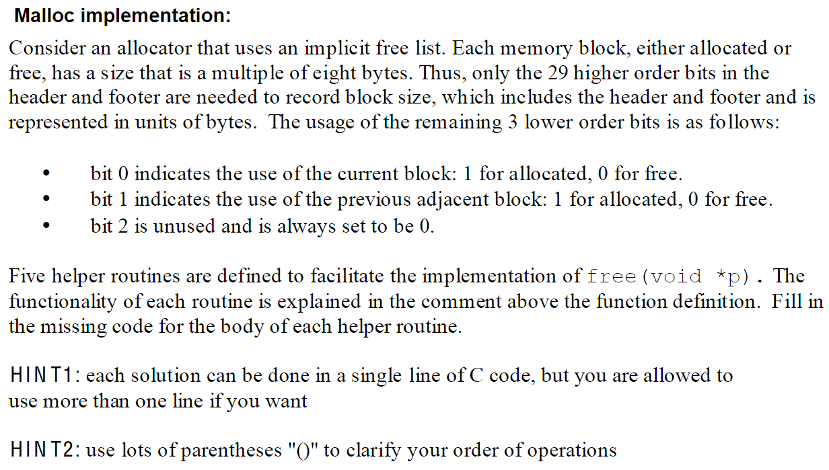
Quiz

Slide 29
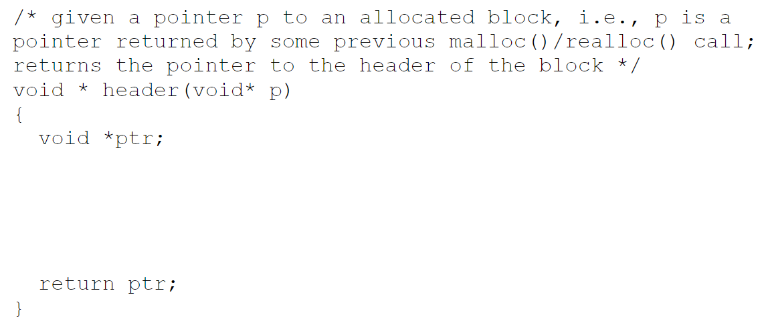
1

Slide 30
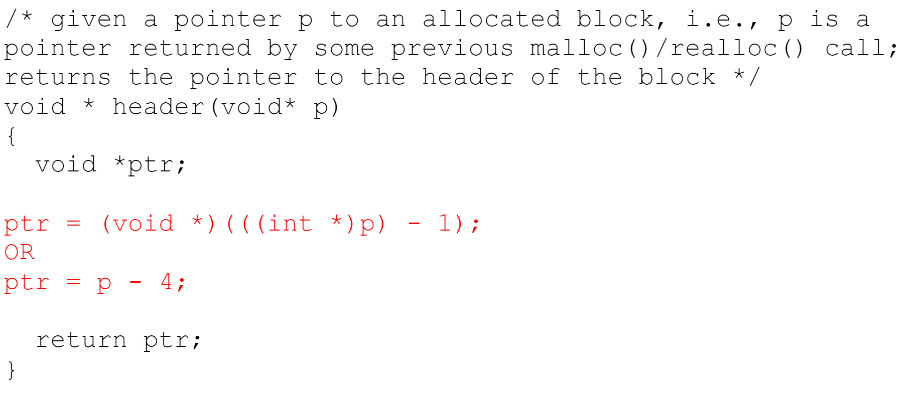
Answer

Slide 31
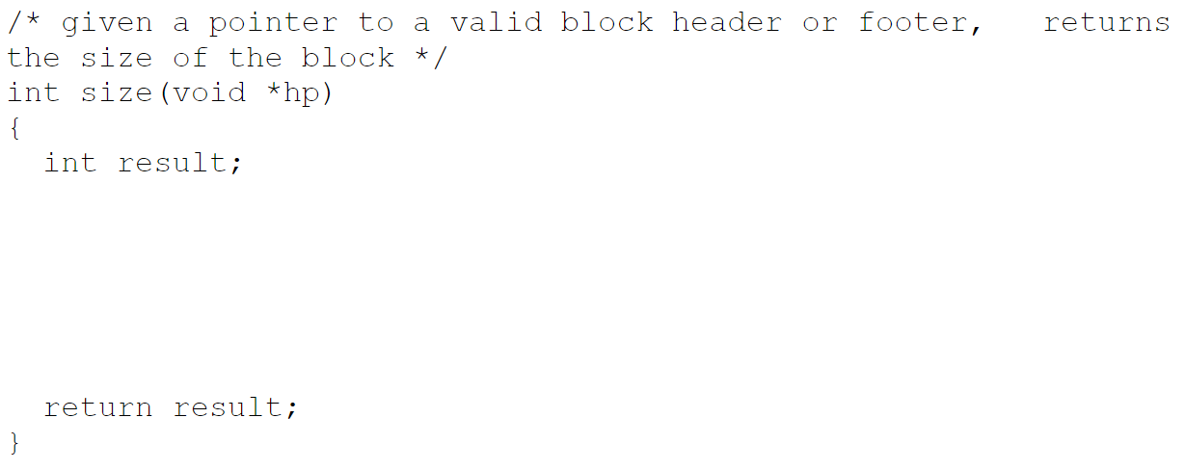
2

Slide 32
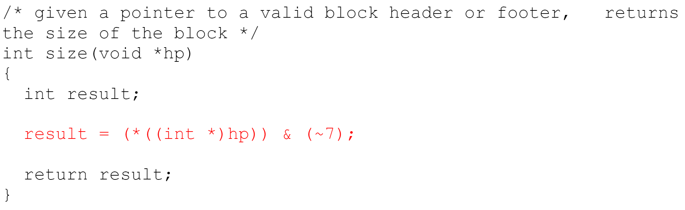
Answer

Slide 33
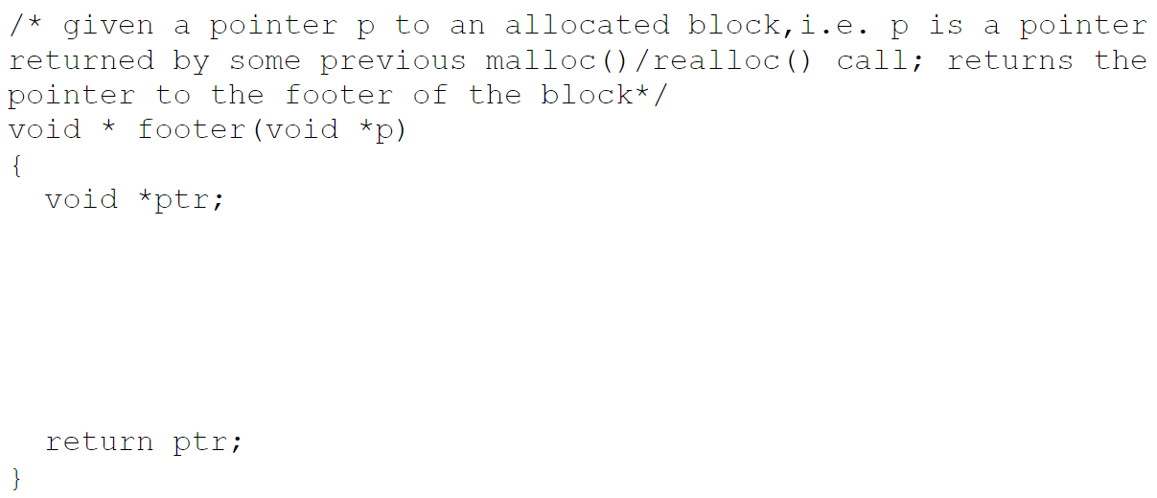
3

Slide 34
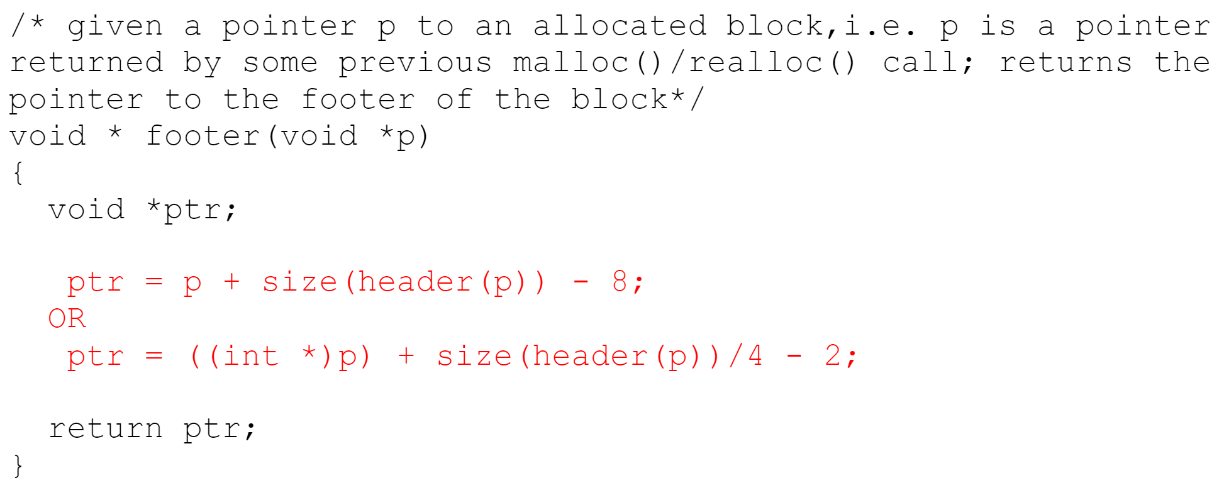
Answer

Slide 35
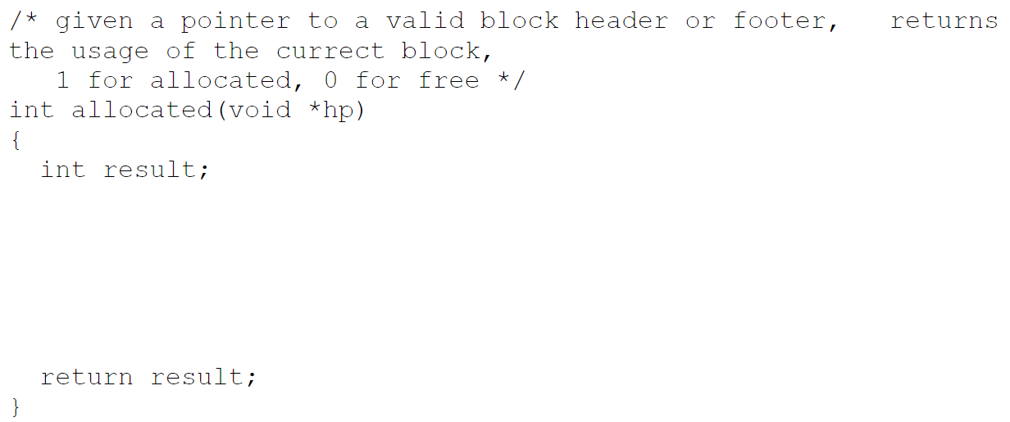
4

Slide 36
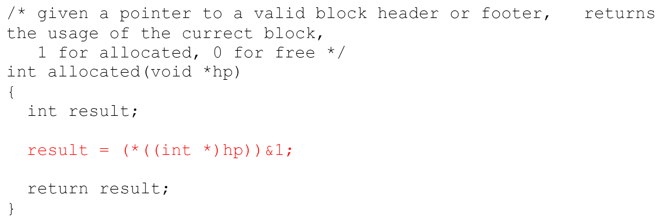
Answer

Slide 37
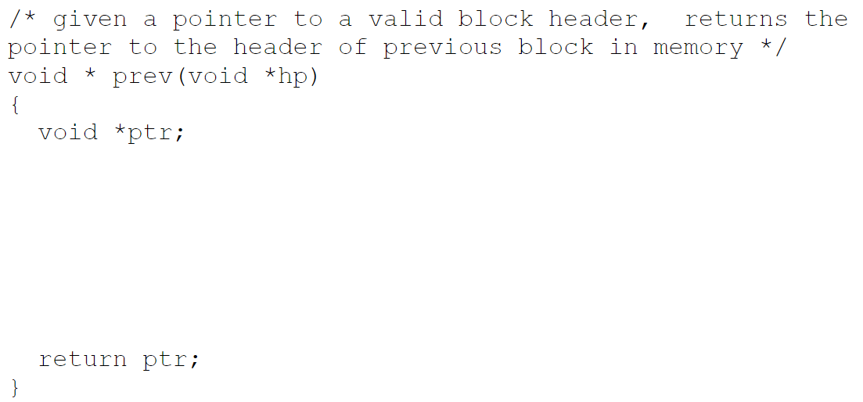
5

Slide 38
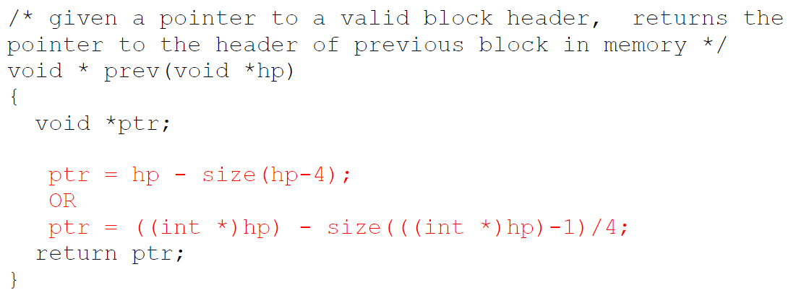
Answer

